Slide 1

What will be the next
Disney Blockbuster?
Matt Weiper / Hema Vyas

Slide 2

What we want to Accomplish
Looking into data, which factors contribute to making a Disney movie better than the rest. Using our findings, can we predict which kind of Disney movies are going to be highly successful moving forward?
Questions we asked Ourselves
Does genre and rating factor into how the movies perform?
Does the month in which movie was released matter in terms of how much it grosses?
Drilling down data to last 10 years, does it represent the same answer we got for entire dataset?
What are some outside factors that could of determined the movies performance?

Slide 3
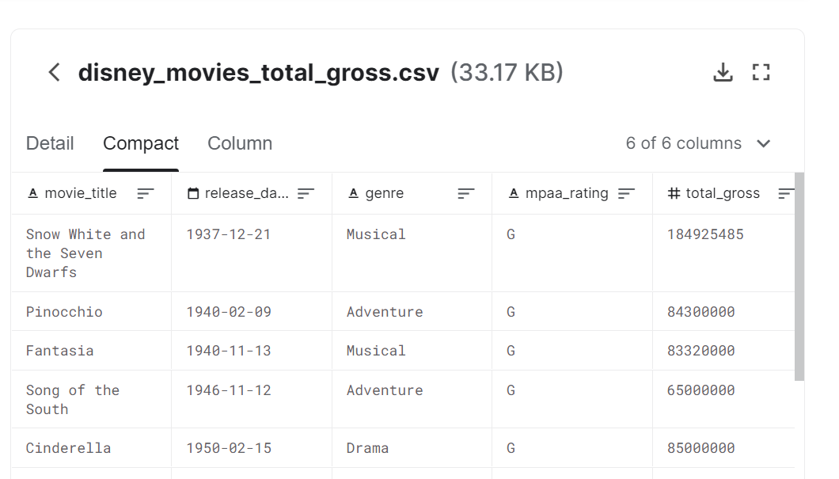

Getting Started
In order to get answers for our questions we wanted to find a good reliable dataset, which had columns for release data, genre, rating, and gross.
We believed with that data we could create new dataframes comparing specific columns, as well as creating plots to really give us answers in finding what makes a Disney blockbuster!
Dataset URL - https://www.kaggle.com/rashikrahmanpritom/disney-movies-19372016-total-gross

Slide 4
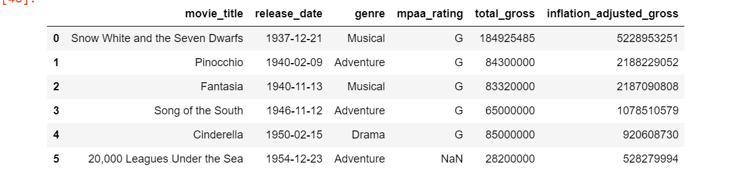

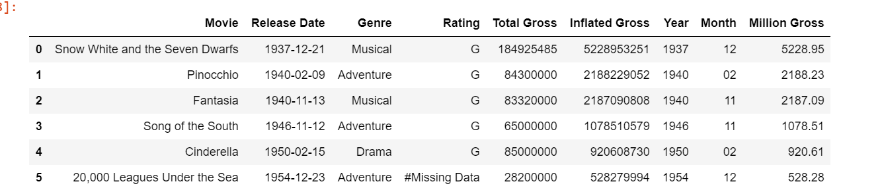
Data Cleanup
Before
The dataset used is from 1937-2016
For all our analysis we are using inflated adjusted gross
After

Slide 5
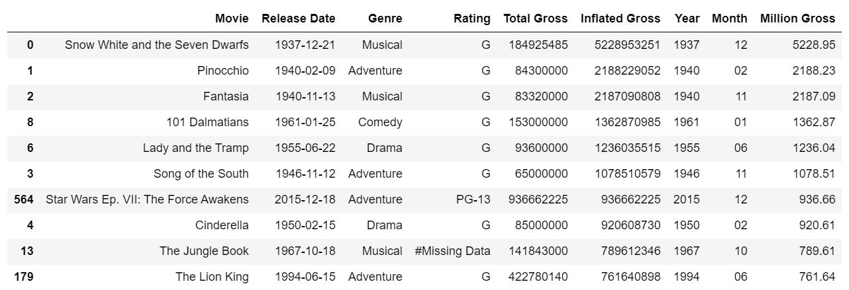

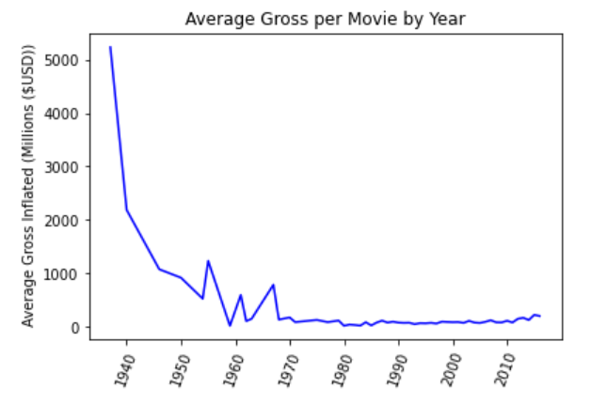
Yearly Data
Skewed data from early Disney days

Slide 6
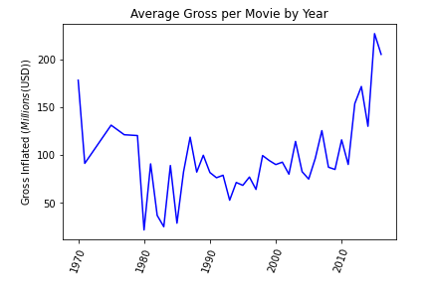
Filter Data from 1970-2016

Slide 7
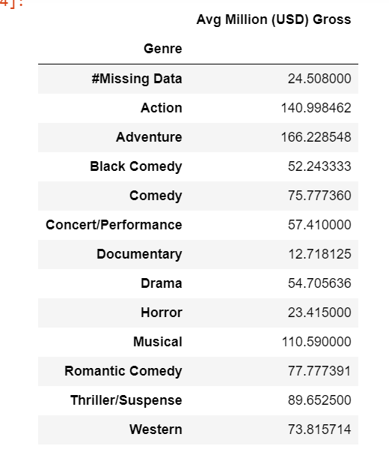
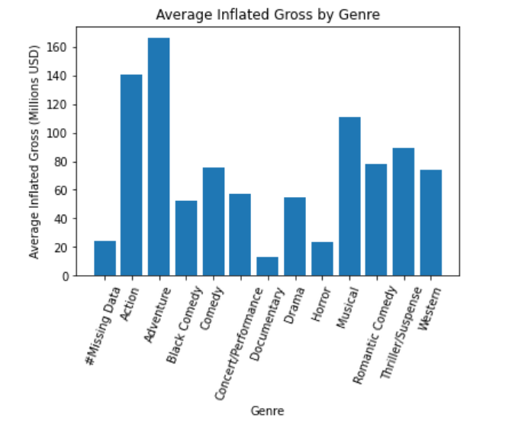

What information can we gather by looking at Genre?
Avg Inflated gross per movie by genre

Slide 8
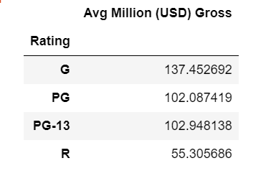
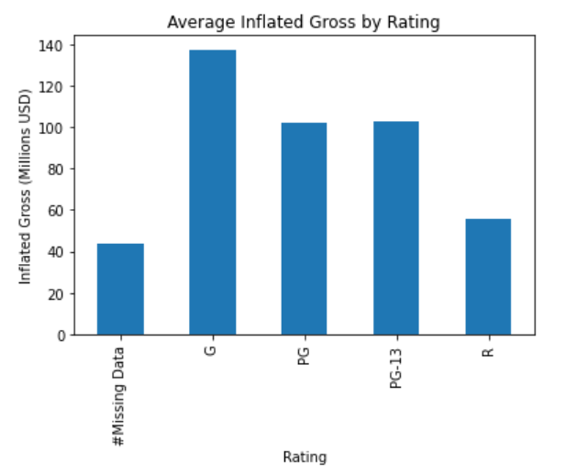

What information can we gather by looking at Rating?
Avg Inflated gross per movie by rating

Slide 9
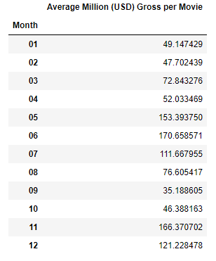
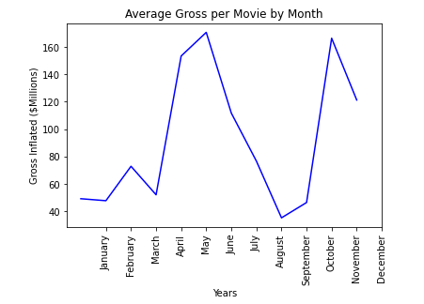
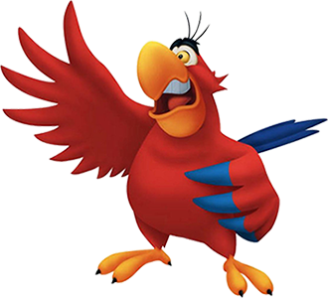
Monthly Data

Slide 10
Comparison to Current Day

Slide 11
Takeaways

